Slide 1

Bayes Classification
Bryan Prudil

Slide 2
AGENDA
Background
Applicability to INFO 523
Real World Applications
Worked Example
Conclusion
References

Slide 3
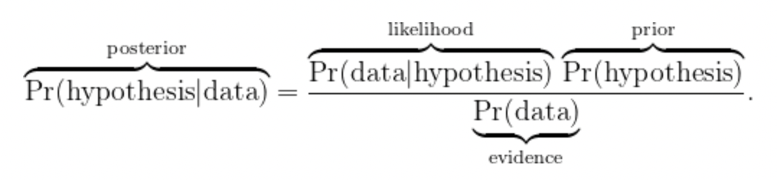

BACKGROUND
Bayesian classifiers
- Under the umbrella of supervised learning algorithms (classification)
- Trained using labeled data
- Class label is predicted for a given example of input data
- Based on Bayes Theorem
$P\left(y | X\right)= \frac{P\left(X | y\right)P(y)}{P(X)}$
Notes:
Bayesian classifiers use Bayes’ theorem in the classifier’s decision rule. Naïve Bayes Classifier uses the Bayes’ theorem to predict membership probabilities for each class such as the probability that given record or data point belongs to a particular class. The class with the highest probability is considered as the most likely class. This is also known as the Maximum A Posteriori (MAP).

Slide 4
BACKGROUND
Bayes vs Naïve Bayes Classification
- Special case of Bayes
- Naive Bayes assumes is that each feature makes an independent and equal contribution to the outcome

Slide 5
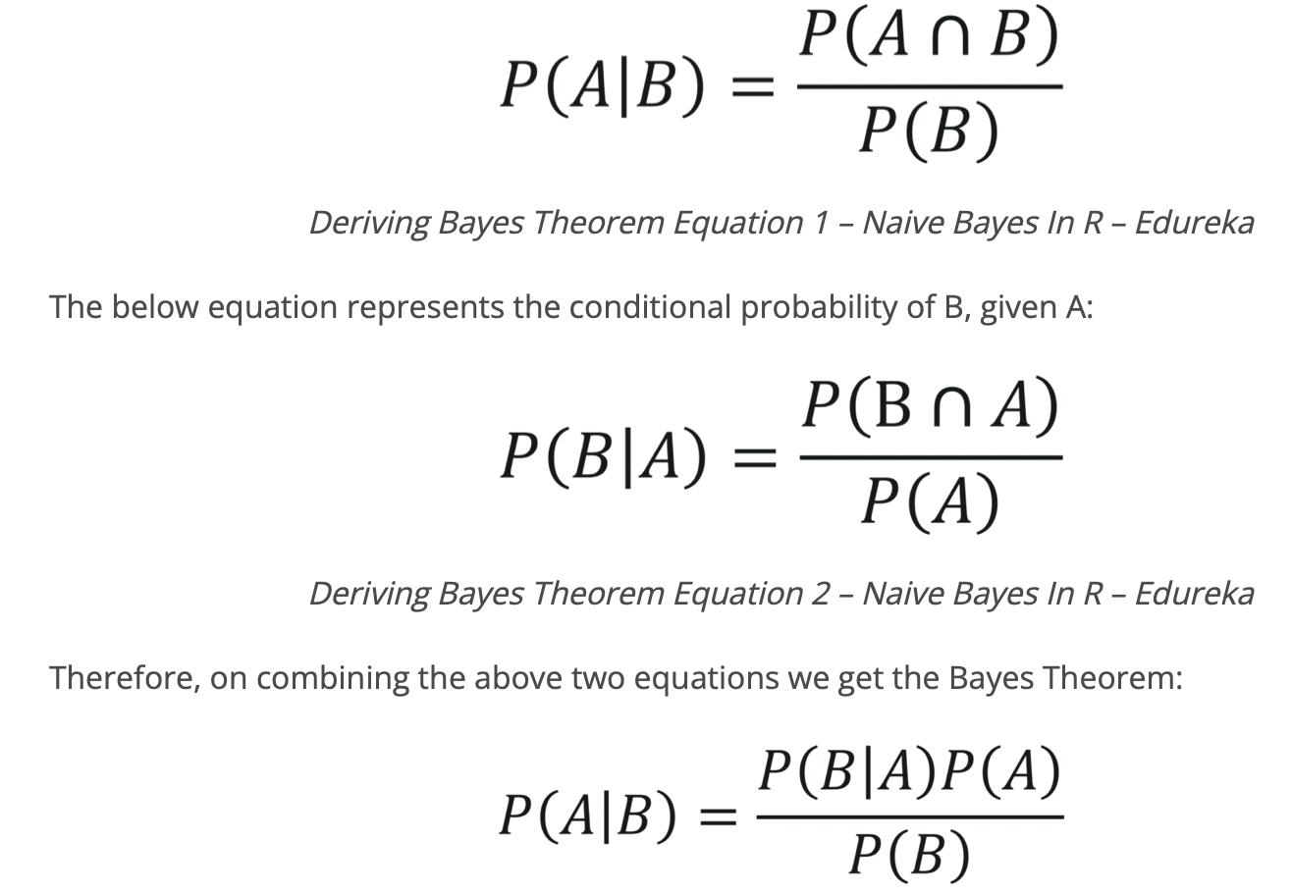
BACKGROUND

Slide 6
APPLICABILITY TO INFO 523
A classification algorithm
- Supervised learning
A viable option to discover useful patterns and information

Slide 7
APPLICATIONS
Relatively simple and straightforward to deploy
- Able to handle large datasets
Successfully deployed in:
- Email filtering
- Spam detection
- Document/text categorization

Slide 8
WORKED EXAMPLE
See my GitHub repository for all applicable code

Slide 9
CONCLUSION
Recommendations:
Future Work:

Slide 10
REFERENCES
[1] https://www.geeksforgeeks.org/naive-bayes-classifiers/
[2] https://arxiv.org/pdf/0908.3817.pdf?fbclid=IwAR3onB3mMa5UdHPfBh
[3] https://www.r-bloggers.com/2015/02/bayesian-network-in-r-introduction/
[4] https://www.bnlearn.com/about/teaching/slides-bnshort.pdf
[5] https://www.edureka.co/blog/naive-bayes-in- r/#Practical%20Implementation%20of%20Naive%20Bayes%20In%20R

Slide 11
THANK YOU

